Slide 1
Exact Exponential-Time Algorithms
Advanced Algorithms 2025/2026
Johan M. M. van Rooij
Til Miltzow
TexPoint fonts used in EMF.
Read the TexPoint manual before you delete this box.: AAAAAAAA

Slide 2
Solution quality Computation time | Optimal | Bound on quality | Good solution, no quality guarantee
Polynomial | Polynomial-time solution algorithms | Approximation algorithms | Construction heuristics
Super polynomial and/or no guarantee | Exact algorithms: Tree search Dynamic programming Integer linear programming …… | Hybrid algorithms Column generation without complete branch-and-price | Meta heuristics: Local search Genetic algorithms
Notes:
I borrowed this slide from Marjan van den Akker.

Slide 3
Solution quality Computation time | Optimal | Bound on quality | Good solution, no quality guarantee
Polynomial | Polynomial-time solution algorithms | Approximation algorithms | Construction heuristics
Super polynomial and/or no guarantee | Exact algorithms: Tree search Dynamic programming Integer linear programming …… | Hybrid algorithms Column generation without complete branch-and-price | Meta heuristics: Local search Genetic algorithms
Algorithms
and networks
Algorithms
and networks
Notes:
Explore the fundamentals of what can algorithmically be done on hard problems.
Focus on what can be done while still obtaining optimal solution quality.

Slide 4
What to do if a problem is NP-complete?
Solve on special cases (graph classes)
Heuristics and approximations
Algorithms that are fast on average
Good exponential-time algorithms
…
Exact exponential-time algorithms are one of many options
Practical applications exist
If the instance is small, and a simple exponential-time algorithm exist, then why not use it?
Sometimes useful as a quick way to solve small subproblems
If one needs the guarantee that an optimal solution is always to be found one has little other choice

Slide 5
Exact exponential-time algorithms in this course
Three Topics
Introduction to exponential-time algorithms
Overview of some techniques
Inclusion/Exclusion
Many ideas from exact exponential-time algorithms are also related/applicable to parameterised algorithms (FPT)
Notes:
Topics split over the lectures

Slide 6
INTRODUCTION
Exponential-time algorithms – Advanced Algorithms

Slide 7
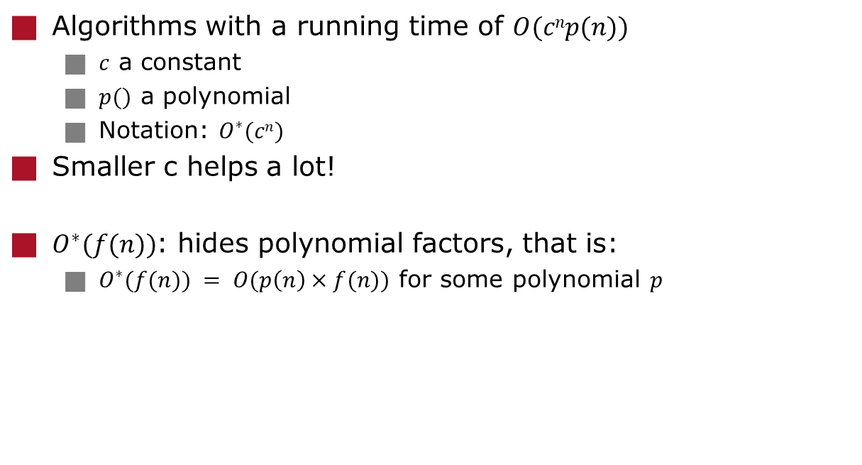
Good exponential-time algorithms
Algorithms with a running time of $O(cnp(n))$
$c$ a constant
$p()$ a polynomial
Notation: $O^{∗}(cn)$
Smaller c helps a lot!
$O^{∗}(f(n))$: hides polynomial factors, that is:
$O^{∗}(f(n)) = O(p\left(n\right)×f(n))$ for some polynomial $p$

Slide 8
Good exponential-time algorithms improve upon the trivial algorithm
What would be a trivial algorithm for the following problem?
Maximum Independent Set:
Instance: graph G = (V,E), integer k.
Question: does G have an independent set of size ¸ k?
An Independent set is a subset of the vertices s.t. no two vertices are adjacent
What would we consider a trivial algorithm in general?
For problems in NP (e.g. NP-Complete problems), the answer involves the definition of P and NP:
... I give the answer after a short recap on P and NP

Slide 9
P and NP
A decision problem belongs to the class P if there is a algorithm solving the problem with a running time that is polynomial in the input size
A decision problem belongs to the class NP if:
Any solution y leading to ‘yes' can be encoded in polynomial space with respect to the size of the input x
Checking whether a given solution leads to `yes' can be done in polynomial time with respect to the size of x and y
Slightly more formal:
Problem Q belongs to the class NP, if there exists a polynomial-time 2-argument algorithm A, such that:
For each instance i, i is a yes-instance to Q, if and only if, there is a polynomial-size certificate c for which A(i,c) = true
Notes:
Hier bij stilstaan: check of de stof in algorithms for decision support over gekomen is.

Slide 10
Certificates
What are natural certificates for the following problems?
Maximum Independent Set:
Instance: graph G = (V,E), integer k.
Question: does G have an independent set of size ¸ k?
Travelling Salesman Problem:
Instance: n vertices (cities) with distance between every pair of vertices, integer k.
Question: Is there shortest (simple) cycle that visits every city of total length · k?
4
1
2
3
2
5
2
3
2
4
11
Notes:
Dit interactief doen!
En wat are certificates for Travelling Salesman Problem?

Slide 11
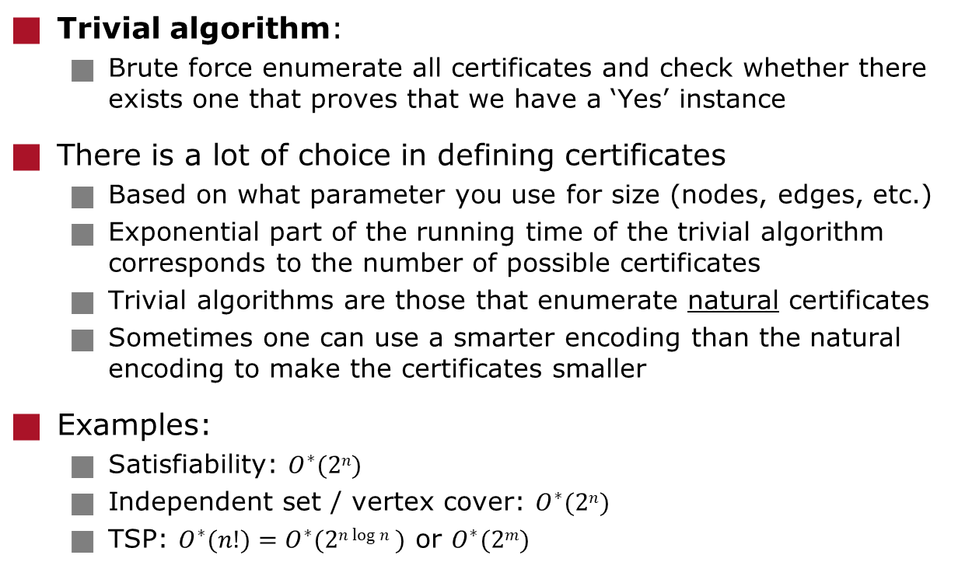
Good exponential-time algorithms improve upon the trivial algorithm
Trivial algorithm:
Brute force enumerate all certificates and check whether there exists one that proves that we have a ‘Yes’ instance
There is a lot of choice in defining certificates
Based on what parameter you use for size (nodes, edges, etc.)
Exponential part of the running time of the trivial algorithm corresponds to the number of possible certificates
Trivial algorithms are those that enumerate natural certificates
Sometimes one can use a smarter encoding than the natural encoding to make the certificates smaller
Examples:
Satisfiability: $O^{∗}(2n)$
Independent set / vertex cover: $O^{∗}(2n)$
TSP: $O^{∗}(n!)=O^{∗}(2n log⁡n )$ or $O^{∗}(2m)$
Notes:
Question: what is the number of possible certificates for:
Max Independent Set?
k-Sat?
TSP?

Slide 12
Time and space
Exact exponential-time algorithms are often compared on two/three properties:
Running time
Space usage
(Parallelization)
Exponential time is a resources we often have
If the input is small and the algorithm is fast enough
Just keep your computer running all night (or worse)
Exponential space can be a much bigger problem
One can easily use all your computer's memory
Algorithms that require a lot of disk swapping often are too slow for practical usage
Notes:
In mijn opinie zou parallellisatie hier even belangrijk moeten zijn.

Slide 13
OVERVIEW OF SOME TECHNIQUES
Exponential-time algorithms – Advanced Algorithms

Slide 14
Content of this lecture
Three Topics
Introduction to exponential-time algorithms
Overview of some techniques
Clever enumeration
Dynamic programming
Branching algorithms (divide and conquer)
Meet in the middle (a.k.a. Sort and Search)
Inclusion/Exclusion

Slide 15
CLEVER ENUMERATION
Exponential-time algorithms – Advanced Algorithms

Slide 16
Enumeration for maximum independent set
Maximum Independent Set:
Instance: graph G = (V,E), integer k
Question: does G have an independent set of size ¸ k?
Algorithm:
If |V| = 0, return 0
Choose a vertex v 2 V of minimum degree
For v and each neighbour of v: u 2 N[v]
Solve the subproblem on G\N[u] (G without u and its neighbours)
Return 1 + the maximum size solution found

Slide 17
Analysis of enumeration for maximum independent set
Algorithm:
If |V| = 0, return 0
Choose a vertex v 2 V of minimum degree
For v and each neighbour of v: u 2 N[v]
Solve the subproblem on G\N[u] (G without u and its neighbours)
Return 1 + the maximum size solution found
We generate d(v) + 1 sub- problems, each with at least d(v) + 1 vertices removed
T(n) · s £ T( n – s )
Where T(n) is the number of leaves of the seach tree on a graph with n vertices, and s = d(v) + 1
One can show T(n) = O*(s^{n/s})
s^{n/s} is maximal w.r.t. positive integer values s if s = 3
So: T(n) = O*(3^{n/3}) = O( 1.4423^{n} )
This improves the trivial O*( 2^{n} ) algorithm
Notes:
Question to students: why did I omit the * in O(1.4423^{n}) , i.e., why not O*(1.4423^{n}) -> lazy and not necessary.
Why is this faster than brute force? We omit lots of possible brute-force solutions.

Slide 18
Maximum and maximal independent sets
Maximum independent set:
Maximum size over all independent sets in G
Maximal independent set:
Maximal in the sense that we cannot add a vertex to the set
We will use a slight modification of the algorithm to enumerate all maximal independent sets
Because each leaf of the search tree contains at most one maximal independent set, this also proves a bound on the number of maximal independent sets in a graph
Corollary:
Any graph contains at most O(1.4423^{n}) maximal independent sets
Notes:
Algorithm of the corollary on next slide!

Slide 19
The enumeration algorithm
Algorithm (for enumerating maximal independent sets):
If |V| = 0, return ;
Choose a vertex v 2 V of minimum degree
For v and each neighbour of v: u 2 N[v]
Solve the subproblem on G\N[u] (G without u and its neighbours), add u to the generated solutions
Return all maximal independent sets found
All maximal independent sets can be enumerated in O*(3^{n/3}) = O( 1.4423^{n} ) time
Each leaf of the search tree at most one maximal independent set: so any graph has at most O*(3^{n/3}) = O(1.4423^{n}) maximal independent sets
This bound is tight: consider a collection of triangles
Notes:
Deze relatie tussen enumeratie en looptijden zien we vaker voor complexe problemen.

Slide 20
Graph colouring
Graph Colouring
Given: Graph G=(V,E), integer k
Question: Can we colour the vertices with k colours, such that for all edges {v,w} in E, the colour of v differs from the colour of w
k-Colouring
Given: Graph G=(V,E)
Question: Can we colour the vertices with k colours, such that for all edges {v,w} in E, the colour of v differs from the colour of w
1
2
2
3
3
1
2
Notes:
Q: can we colour this graph with 2 colours?
Q: can we colour this graph with 4 colours?

Slide 21
Graph colouring
1-Colouring is easy in O(n) time (or O(1))
2-Colouring is easy in O(n+m) time
k-Colouring is NP-Complete for k ¸ 3
Applications:
Scheduling
Frequency assignment
...
Practical problems are usually more complex variants of the standard graph colouring problem
Notes:
Discuss:
How to do 2 colouring?
NP-completeness? Hoe relateert dit zich tot de 4-colour theorem?

Slide 22
3-Colouring
O*(3^{n}) is trivial or can we do this faster?
G is 3-colourable, if and only if, there is a set of vertices S with:
S is an independent set
G[V-S] is 2-colourable
Algorithm: enumerate all sets and test these properties
2^{n} tests of O(n+m) time each
So, depending on how we define certificates, 3-colouring is ‘trivial’ to solve in O*(3^{n}) or O*(2^{n}) time
Notes:
Discuss certificates before 2nd click.

Slide 23
3-Colouring
Lawler, 1976: G is 3-colourable, if and only if, there is a set of vertices S with:
S is a maximal independent set
G[V-S] is 2-colourable
Enumerating all maximal independent sets in O*(3^{n/3}) = O(1.4423^{n}) time
Thus O(1.4423^{n}) time algorithm for 3-colouring
Schiermeyer, 1994: O(1.398^{n}) time
Beigel, Eppstein, 1995: O(1.3446^{n}) time
Beigel, Eppstein, 2005: O(1.3289^{n}) time
Lucas Meijer (PhD @ UU), 2023: O(1.3217^{n}) time

Slide 24
4-Colouring in O*(2^{n}) time
Lawler, 1976: G is 4-colourable, if and only if, we can partition the vertices in two sets X and Y such that:
G[X] and G[Y] are both 2-colorable
Enumerate all partitions in O*(2^{n}) time
For each, check both halves in O(n+m) time
k-colouring is ‘trivial’ to solve in O*( dk/2e^{n} ) time
Enumerate all partitions into dk/2e disjoint sets
Check that each partition is 2-colourable (if k is odd, for all but one partition)
Notes:
Certificates again. What is trivial here for k-colouring?

Slide 25
Faster 4-colouring
Using 3-Colouring:
Enumerate all maximal independent sets S
For each, check 3-colourability of G[V-S]
1.4423^{n} * 1.3217^{n} = 1.9063^{n}
Better: there is always a colour with at least n/4 vertices
Enumerate all m.i.s. S with at least n/4 vertices
For each, check 3-colourability of G[V-S]
1.4423^{n} * 1.3217 ^{3n/4} = 1.7779^{n}
Byskov, 2004: O(1.7504^{n}) time
Fomin, Gaspers, Saurabh, 2007: O(1.7272^{n}) time

Slide 26
DYNAMIC PROGRAMMING
Exponential-time algorithms – Advanced Algorithms

Slide 27
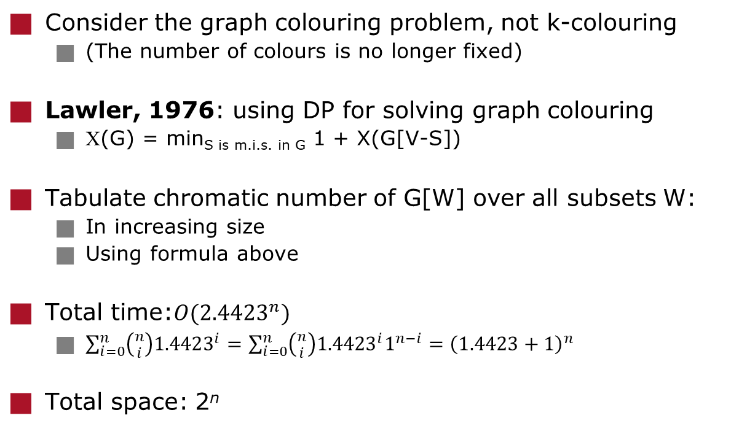
Graph colouring with dynamic programming
Consider the graph colouring problem, not k-colouring
(The number of colours is no longer fixed)
Lawler, 1976: using DP for solving graph colouring
Χ(G) = min_{S is m.i.s. in G} 1 + X(G[V-S])
Tabulate chromatic number of G[W] over all subsets W:
In increasing size
Using formula above
Total time:$O({2.4423}^{n})$
$\sum_{i=0}^{n}{\left({n \atop i}\right){1.4423}^{i}}=\sum_{i=0}^{n}{\left({n \atop i}\right){1.4423}^{i}1^{n−i}={\left(1.4423+1\right)}^{n}}$
Total space: 2^{n}
Notes:
Time usage on blackboard or interactive.

Slide 28
Graph colouring
Lawler 1976: O(2.4423^{n}) (improved analysis)
Eppstein, 2003: O(2.4151^{n})
Byskov, 2004: O(2.4023^{n})
All using O*(2^{n}) memory
Improvements on DP method
Björklund, Husfeld, 2005: O(2.3236^{n})
Björklund, Husfeld, 2006: Inclusion/Exclusion: O*(2^{n})
The last algorithm will be in the next lecture!
Notes:
2.4423^{n} tijd kun je bewijzen op blackboard via binomium van Newton.

Slide 29
Held-Karp algorithm for Travelling Salesman Problem
Take one starting vertex s arbitrarily
For set of vertices S µ V\{s} , vertex v ∈ S, let:
B(S,v) = minimum length of a path, that:
Starts in s
Visits s and all vertices in S (and no other vertices)
Ends in v
Algorithm:
B({v},v) = d(s,v)
For j = 2 to |V|-1:
For all sets S, |S| = j, for all v ∈ S:
B(S,v) = min_{w∈S\{v}}{ B(S\{v},w}) + d(w,v) }
Return min{ B(V\{s},v) + d(v,s) | v ∈ V }
4
1
2
3
2
5
2
3
2
4
11
Notes:
This algorithm should be familiar (algorithms course, algorithms for decision support course).

Slide 30
Held-Karp algorithm for TSP
4
1
2
3
Algorithm:
B({v},v) = d(s,v)
For j = 2 to |V|-1:
For all sets S, |S| = j:
For all v ∈ S:
B(S,v) = min_{w∈S\{v}}{ B(S\{v},w}) + d(w,v) }
Return min{ B(V\{s},v) + d(v,s) | v ∈ V }
This improves the trivial O*( n! ) algorithm
Time: O(n²2^{n})
Space: O(n2^{n})
2
5
2
3
2
4
11

Slide 31
BRANCHING ALGORITHMS (DIVIDE AND CONQUER)
Exponential-time algorithms – Advanced Algorithms

Slide 32
Branching algorithm: divide and conquer
Branching Algorithm:
Algorithm that splits the current problem instance into multiple easier subinstances that are solved recursively
Earlier example: maximum/maximal independent set algorithm
Let T(n) be the number of subproblems generated on an instance of size n
Analysis of branching algorithm generating k subproblems, where subproblem i is d_{i} smaller than the original instance:
T( n ) · T( n – d₁ ) + T( n – d₂ ) + … + T( n – d_{k} ) + 1
T( 1 ) = 1
Solution of this recurrence is O*( a^{n} ) where a is the solution to: x^{n} – x^{n-d1} – x^{n-d2} - … - x^{n-dk} = 0
a often denoted as ¿( d₁, d₂, …, d_{k} )
Notes:
Different from algorithms course one does not use the Master Theorem here to analyse recurrences.
Not of the form T(n) < a T(n/b) + f(n)

Slide 33
Branching algorithm for k-SAT
k-SAT (k-Satisfiability):
Instance: set of clauses C (logical formula in CNF format) where each clause contains at most k literals
Question: does there exist a satisfying assignment to the variables in C, i.e., a truth assignment such that each clause has at least one literal set to true?
Trivial algorithm: O*(2^{n})
Notes:
Why is this the trivial algorithm?

Slide 34
Branching algorithm for k-SAT
Algorithm (for k-SAT formula F):
If F contains the empty clause: return false
If F is the empty formula: return true
Choose the smallest clause ( l₁, l₂, ..., l_{c} ) from F
Recursively solve:
F with l₁ = true
F with l₁ = false, l₂ = true
...
F with l₁ = false, l₂ = false, ..., l_{c-1} = false, l_{c} = true
Return true if and only if any recursive call returned true

Slide 35
Branching algorithm for k-SAT: analysis
Algorithm is correct since in each clause at least one literal must be set to true
Recurrence relation describing the algorithm:
T( n ) · T( n – 1 ) + T( n – 2 ) + … + T( n – c )
Worst case:
T( n ) · T( n – 1 ) + T( n – 2 ) + … + T( n – k )
For different values of k, this leads to:
k = 3: ¿( 1,2,3 ) < 1.8393 O( 1.8393^{n} )
k = 4: ¿( 1,2,3,4 ) < 1.9276 O( 1.9276^{n} )
k = 5: ¿( 1,2,3,4,5 ) < 1.9660 O( 1.9660^{n} )

Slide 36
Reduction rules for independent set
Often, branching algorithms use reduction rules
Rules that simplify the instance without branching
For Maximum Independent Set we can formulate the following rules for any v 2 V:
Reduction rule 1: if v has degree 0, put v in the solution set and recursively solve on G-v
Reduction rule 2: if v has degree 1, then put v in the solution set. Suppose v has neighbour w. Recursively solve G – {v,w}
If v has degree 1, then there is always a maximum independent set containing v
Reduction rule 3: if all vertices of G have degree at most two, solve the problem directly. (Easy in O(n) time.)

Slide 37
A faster algorithm
New branching rule:
Take vertex v of maximum degree
Take best of two recursive steps:
v not in solution: recurse on G – {v}
v in solution: recurse on G – N[v]; add 1 to solution size
Algorithm:
Exhaustively apply all reduction rules
Apply branching rule
Analysis:
T(n) ≤ T(n – 1) + T(n – 4), as v has degree at least 3, we lose at least 4 vertices in the second case
O*( ¿(1,4)^{n} ) = O(1.3803^{n})
This is faster than the O(1.4423^{n}) enumeration algorithm

Slide 38
Maximum independent set: final remarks
More detailed analysis gives better bounds
Many possibilities for improvement
Many papers with huge case analyses exist
Long time best known: O(1.1844^{n}) (Robson, 2001)
Extensive, computer-generated case analysis!
Includes memorization (DP)
Improved (I think), often discussions on correctness of such partially computer-generated algorithms
The measure-and-conquer technique allows for better analysis of branch and reduce algorithms (Fomin, Grandoni, Kratsch, 2005)
Much simpler algorithm and only slightly slower compared to Robson

Slide 39
Back to 3-SAT: branching and local search
Idea: use an exponential-time branching algorithm to search a ‘local’ neighbourhood of possible solutions
Consider 3-Satisfiability
For two truth assignment a₁ and a₂ that assign true/false to the variables x₁, ..., x_{n}, we define the Hamming distance to be the number of variables on which a₁ and a₂ differ
Lemma:
Given any truth assignment a and a 3-SAT formula F, we can decide in O*(3^{d}) time whether there is an truth assign-ment that satisfies F at Hamming distance at most d from a

Slide 40
Searching the Hamming-ball
Lemma:
Given any truth assignment a and a 3-SAT formula F, we can decide in O*(3^{d}) time whether there is an truth assign-ment that satisfies F at Hamming distance at most d from a
Proof:
If truth assignment a is not a satisfying assignment, then there is a clause C that is not satisfied by a
In any satisfying assignment at least one of the literals in C must be flipped: we generate a subproblem for each literal in C where the value of the corresponding variable is flipped
If there is a satisfying assignment at Hamming distance at most d, then we should find it after branching d times in this way
So, this requires O*(3^{d}) time
For k-SAT this can be done in O*(k^{d}) time

Slide 41
A simple local search algorithm for 3-Satisfiability
Any truth assignment lies either at Hamming distance at most n/2 from the all-true or the all-false assignment
Algorithm:
Apply the local search algorithm and look within the Hamming-Balls of size n/2 from the all-true and all-false assignments
Running time: O*(3^{n/2}) = O(1.7321^{n})
This already improves the O(1.8393^{n})-time branching algorithm we saw earlier
Using randomisation this can be improved greatly…
See Jesper’s lectures

Slide 42
MEET IN THE MIDDLE (OR SORT AND SEARCH)
Exponential-time algorithms – Advanced Algorithms

Slide 43
Subset Sum
Subset sum problem:
Given: set of positive integers S = {a₁,a₂,..,a_{n}}, integer t
Question: Is there a subset of S with total sum t?
Example:
S = {1,2,3,8,12,15,27}
t = 34
Example 2:
S = {1,2,3,8,12,15,27}
t = 33
Notes:
Example 1: not possible: 27 + 3 + 2 + 1 is too little, yet 27 + 8 to big. Without 27, need 15 (rest too small), but 15 without 12 too small and 15+12+ 8 to big, 15+12+3+2+1 too small.
Example 2: 27 + 3 + 2 + 1, or 15 + 12 + 3 + 2 + 1.

Slide 44
Sort and Search: algorithm Split instance in two and let solutions ‘meet in the middle’
Algorithm:
We split S into two subsets S₁ and S₂: S₁ = {a₁,a₂,…,a_{n/2}}, S₂ = {a_{n/2+1},a_{n/2+2},…,a_{n}}
For S₁ and S₂ we compute 2^{n/2} size tables containing all sums that can be made using elements from S₁ and S₂ respectively
Sort the two tables in O(2^{n/2} log(2^{n/2})) = O*(2^{n/2}) time
Start with the smallest value in S₁ and the largest value in S₂ and repeat these steps:
Move one value further in S₁ if the sum is too small
Move one value back in S₂ if the sum is too large
Output ‘Yes’ if the sum is exactly t
Output ‘No’ if we finished searching S₁ and S₂
Notes:
Ask students: why correct? Running time?

Slide 45
The knapsack problem
Knapsack
Given: Set S of items, each with integer value v and integer weight w, integers W and V
Question: is there a subset of S of weight no more than W, with total value at least V?
We split S into two subsets S₁ and S₂:
S₁ = {s₁, s₂,…, s_{n/2}}, S₂ = {s_{n/2+1}, s_{n/2+2},…,s_{n}}

Slide 46
Sort and Search: knapsack
Algorithm:
For S₁ and S₂ we compute 2^{n/2} size tables containing all subsets of items that can be picked from S₁ or S₂
Sort the sets S₁ and S₂ by their weight
Remove all dominated subsets
Dominated subsets: subsets for which there exists another subset with more (or equal) value and less (or equal) weight
S₁ and S₂ are now sorted increasingly on weight and value
Start with the smallest item in S₁ and the largest item in S₂ and keep track of the highest value combination found:
Update the highest value if the combination of the subset from S₁ and the subset from S₂ is not too large and more valuable as the current most valuable solution
Move one value further in S₁ if the sum of the sizes is too small
Move one value back in S₂ if the sum of the sizes is is too large

Slide 47
Sort and search space improvement
Both algorithms can be improved to use O*(2^{n/2}) time and O*(2^{n/4}) space (Schroeppel, Shamir, 1981)
Compare to O*(2^{n/2}) time and space
Algorithm:
Split S into four subsets S₁, S₂, S₃, S₄ of equal size
For each subset create a sorted table with all possible sums that we can make using elements from that set
We list all possible sums from elements from S₁ [ S₂ in increasing order and all possible sums from elements from S₃ [ S₄ in decreasing order
How? Next Slides
Combining values from the increasing list on S₁ [ S₂ and the decreasing list on S₃ [ S₄ is identical to the previous algorithms
Notes:
When short in time: skip this!

Slide 48
Sort and search space improvement: analysis
Algorithm uses O*(2^{n/4}) space:
Four tables of all values one can make using numbers in S_{i}
Algorithm uses O*(2^{n/2}) time:
If we can list all values from S₁ [ S₂ in increasing order within this amount of time, without using extra space
Similarly for all values from S₃ [ S₄ in decreasing order
Notes:
Why is this correct

Slide 49
Sort and search space improvement: listing the numbers
How to list all elements from S₁ [ S₂ in increasing order?
Select the smallest element e from S₁
Make a priority queue with all e + s₂ with all elements s₂ 2 S₂
Whenever we need the next element we take the smallest element from the priority queue e + s₂ and replace it by e’+s₂ (where e’ is the next biggest element after e in S₁)
Then, return the next smallest element of the priority queue
Priority queue holds tuples (e,s_{i}) with priority e + s_{i}
The priorities cause the numbers to be listed in increasing order
The tuple representation allow (e,s_{i}) to be replaced by (e,s_{i+1}), causing all possible numbers from S₁ [ S₂ to be generated
2^{n/2} updates, each in O*(log(2^{n/4})) time gives O*(2^{n/2}) time

Slide 50
CONCLUSION
Exponential-time algorithms – Advanced Algorithms

Slide 51
Conclusion
We discussed a few standard techniques in exact exponential-time algorithms:
Clever enumeration
Maximum independent set, k-colouring
Dynamic programming
Graph colouring, travelling salesman problem
Branching algorithms
For k-satisfiability and maximum independent set
Sort and Search (a sort of meet in the middle)
For subset sum and knapsack

Slide 52
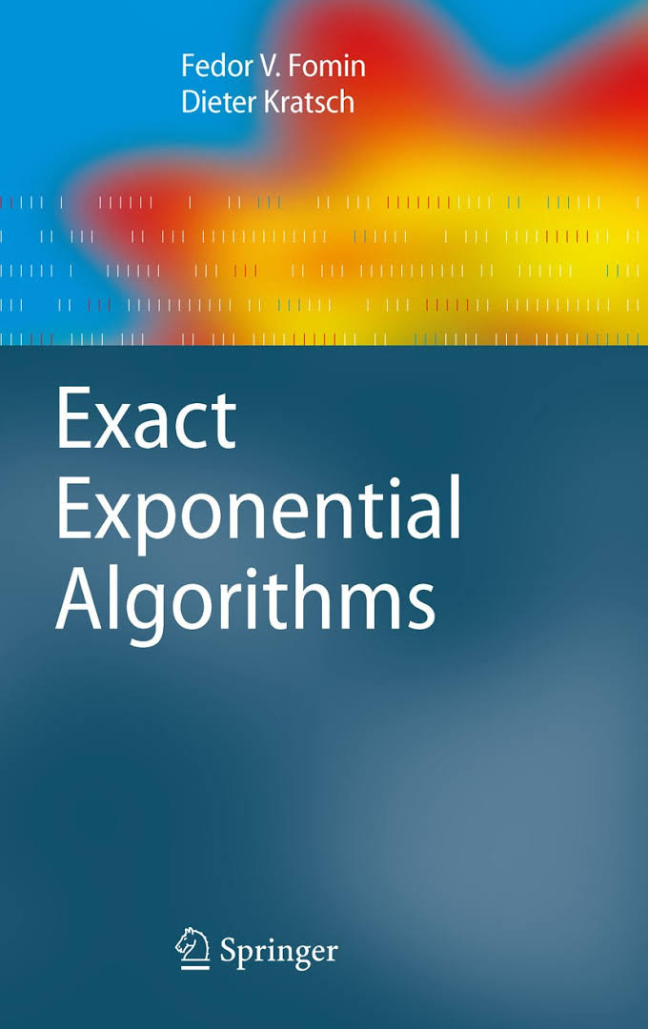
Further reading and exercises (basics of exact exponential-time algorithms)
Fomin and Kratsch Exact Exponential Algorithms Chapters 1, 2, 3

Slide 53
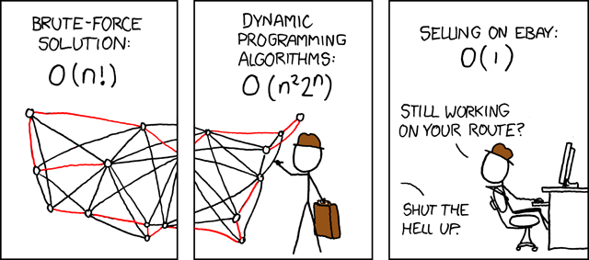
Questions?

Slide 54
Inclusion/Exclusion
Advanced Algorithms 2025/2026
Johan M. M. van Rooij
Til Miltzow
Notes:
Copy question on couting integers to blackboard: nice reference when proving the theorems.

Slide 55
Exact exponential-time algorithms in this course
Three Topics
Introduction to exponential-time algorithms
Overview of some techniques
Inclusion/Exclusion
Many ideas from exact exponential-time algorithms are also applicable to or are related to parameterised algorithms

Slide 56
Question...?
How many integers exist in the range [1,2,...,10.000] with the property that they are:
Not divisible by 2
Not divisible by 3
Not divisible by 5
So:
1,7,11,13,17,19,23,29,31,...
Notes:
If I would let the student puzzle for 5 minutes, I guess some proportion of them would give the correct answer.
But, let us do this in a step-by-step fashion.

Slide 57
Inclusion/exclusion and a Venn diagram
P_{x}: integers divisible by x
|P₂| = 5.000
|P₃| = 3.333
|P₅| = 2.000
10.000 - |P₂| - |P₃| - |P₅| = -333
We subtracted too many!
How many too many?
Lets add some!
P₂
P₅
P₃
1
2
2
3
1
1
2

Slide 58
Inclusion/exclusion and a Venn diagram
|P₂ Å P₃| = 1.666
|P₂ Å P₅| = 1.000
|P₃ Å P₅| = 666
Divisible by 6, 10, 15.
10.000 - |P₂| - |P₃| - |P₅|
+ |P₂ Å P₃| + |P₂ Å P₅| + |P₃ Å P₅| = 2.999
We added too many!
How many?
P₂
P₅
P₃
1
1
1
0
1
1
1

Slide 59
Inclusion/exclusion and a Venn diagram
How many integers exist in the range [1,2,...,10.000] with the property that they are:
Not divisible by 2
Not divisible by 3
Not divisible by 5
|P₂ Å P₃ Å P₅| = 333
10.000 - |P₂| - |P₃| - |P₅| + |P₂ Å P₃| + |P₂ Å P₅|
+ |P₃ Å P₅| - |P₂ Å P₃ Å P₅| = 2.666
P₂
P₅
P₃
1
1
1
1
1
1
1
Notes:
This is the principle of inclusion exclusion.
Copy 10.000 - |P₂| - |P₃| - |P₅| + |P₂ and P₃| + |P₂ and P₅| + |P₃ and P₅| - |P₂ and P₃ and P₅| to blackboard.

Slide 60
What are we going to do in this lecture?
Apply the principle of inclusion/exclusion for faster algorithms
The inclusion/exclusion formula
Algorithmic applications:
Hamilton cycle
Graph colouring

Slide 61
INCLUSION/EXCLUSION FORMULA
Exponential-time algorithms – Advanced Algorithms

Slide 62
The inclusion/exclusion formula in its general form
Let N be a collection of objects (anything)
Let 1,2, ...,n be a series of requirements on objects.
Finally, let for a subset R µ {1,2,...,n}, N(R) be the number of objects in N that do not satisfy the requirements in R
N(;) = |N|
N({1,2...n}) counts objects that satisfy no requirement at all
Then, the number of objects X that satisfy all requirements is:
In the counting integers example:
N = [1,2,....,10.000]
Requirements: integer is not divisible by x, for x = 2, 3, 5
Notes:
Click: link to counting example.
Next: proof.

Slide 63
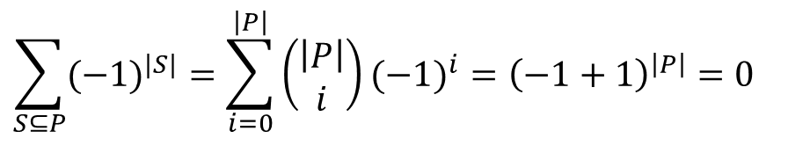
Proof of the inclusion/exclusion formula
The number of objects X that satisfy all requirements is:
Proof:
An object that has all properties is only counted with R=;.
Consider an object that does not have the properties in
P µ {1,2,...,n} is counted once for all S µ P:
By the binomial theorem.
$$\sum_{S⊆P}{(−1)^{|S|}}=\sum_{i=0}^{\left|P\right|}{\left(\begin{matrix}\left|P\right| \\ i\end{matrix}\right)}(−1)^{i}={\left(−1+1\right)}^{\left|P\right|}=0$$
Notes:
Click: link to counting example.
Next: proof.

Slide 64
The inclusion/exclusion formula: alternative proof (that I find more intuitive)
Consider a branching algorithm branching on a requirement:
required = optional – forbidden
‘Not divisible by x’ = ‘can be divisible by x’ – ‘divisible by x’
The full branching tree has 2^{|X|} leaves
Each corresponding to a set R
Requirements not in R are ‘optional’ and can be violated
Requirements in R are ‘forbidden’ and must be violated
If we sum over all 2^{|X|} leaves, we get:
Notes:
On the blackboard: example “How many integers 1,2,...,10.000 not divisible by 2,3, 5.”

Slide 65
INCLUSION/EXCLUSION FOR HAMILTON CYCLE
Exponential-time algorithms – Advanced Algorithms

Slide 66
Space improvement for Hamiltonian cycle
Dynamic programming algorithm for Hamiltonian cycle or TSP uses:
O( n²2^{n} ) time
O( n2^{n} ) space
In practice, space becomes a problem before time does
We now give an algorithm for Hamiltonian cycle that uses:
O(n³2^{n}) time
O(n) space
This algorithm counts Hamiltonian cycles using the principle of inclusion/exclusion

Slide 67
Counting (non-)Hamiltonian cycles
Computing/counting tours is much easier if we do not care about which cities are visited
This uses exponential space in the DP algorithm
Define: Walks[ v_{i}, k ] = the number of ways to travel from v₁ to v_{i} traversing k times an edge
We do not care whether nodes/edges are visited (or twice)
Using Dynamic Programming:
Walks[ v₁, 0 ] = 1
Walks[ v_{i}, 0 ] = 0 for all i > 1.
Walks[ v_{i}, k ] = ∑_{vj ∈ N(vi)} Walks[ v_{j}, k – 1 ]
Walks[ v₁, n ] counts all length n walks that return in v₁
This requires O(n³) time and O(n) space
Notes:
In het Nederlands noem ik dit wel eens de dronken handelsreiziger: tel het aantal mogelijke mogelijke manieren waarop hij rond zwalkt.
O(n) space.... Waarom? Slechts 2 waarden van k hoeven bijgehouden te worden!

Slide 68
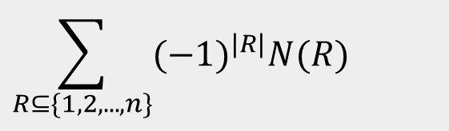
Apply the formula to every city: the inclusion/exclusion formula
Let CycleWalks( V’ ) be the number of walks of length n from v₁ to v₁ using only vertices in V’, then:
Requirements: for each vertex v: visit the vertex v
Formula requires 2^{n} times the counting of cyclic walks through a graph:
O(n³2^{n}) time
O(n) space
$$\sum_{R⊆\{1,2,...,n\}}{(−1)^{|R|}N(R)}$$
Notes:
Click for IE formula.

Slide 69
INCLUSION/EXCLUSION FOR GRAPH COLOURING
Exponential-time algorithms – Advanced Algorithms

Slide 70
Graph colouring with inclusion/exclusion
Björklund and Husfeld, and independently Koivisto, 2006
O*(2^{n}) time algorithm for graph colouring
Covering G with independent sets
Objects to count:
Sequences (I₁,…,I_{k}) where each I_{i} is an independent set
Requirements:
For every vertex v we require that v is contained in at least one independent set I_{i}
Let c_{k}(G) be the number of ways we can cover all vertices in G with k independent sets, where the independent sets may be overlapping, or even the same
Lemma: G is k-colorable, if and only if c_{k}(G) > 0

Slide 71

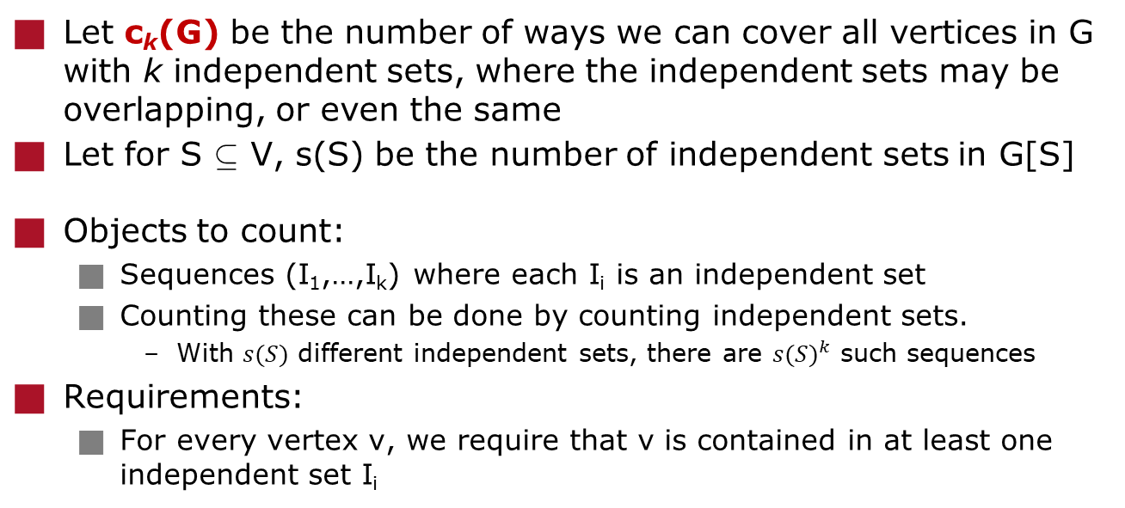
Expressing c_{k} in s
Let c_{k}(G) be the number of ways we can cover all vertices in G with k independent sets, where the independent sets may be overlapping, or even the same
Let for S µ V, s(S) be the number of independent sets in G[S]
Objects to count:
Sequences (I₁,…,I_{k}) where each I_{i} is an independent set
Counting these can be done by counting independent sets.
With $s(S)$ different independent sets, there are ${s(S)}^{k}$ such sequences
Requirements:
For every vertex v, we require that v is contained in at least one independent set I_{i}
$$\sum_{R⊆\{1,2,...,n\}}{(−1)^{|R|}N(R)}$$
Notes:
Deze slide heel rustig op bord opbouwen!

Slide 72
Counting independent sets
Let for SµV, s(S) be the number of independent sets in G[S]
s(S) = s( S\{v} ) + s( S\N[v] ) for some v 2 S
s(;) = 1
We can compute all values s(S) in O*(2^{n}) time
Use bottom-up dynamic programming and store all values
The algorithm:
Compute all s(S) for all S µ V by dynamic programming
For k = 1 up to n:
Compute the value c_{k}(G) with the inclusion/exclusion formula
If c_{k}(G) > 0: return k
O*(2^{n}) time and space

Slide 73
A note on the algorithm
Polynomial space algorithm is also possible
Then we need to compute s(X) each time again
This requires additional exponential time
Running time depends on how fast we count independent sets
O(1.4423^{n}) time enumeration, then O(2.4423^{n}) time total
Gaspers and Lee 2016: O(2.2356^{n})
Lots of techniques:
Measure and conquer
Potentials
Compound measures
Branching to separate the graph
Out of scope for this lecture...

Slide 74
Conclusion
Today we discussed:
The inclusion/exclusion formula
Algorithmic applications:
Hamilton cycle
Graph colouring
Many more applications
Streiner Tree
Different fields of math and/of algorithms
FPT algorithms
Fast subset convolution
P₂
P₅
P₃

Slide 75

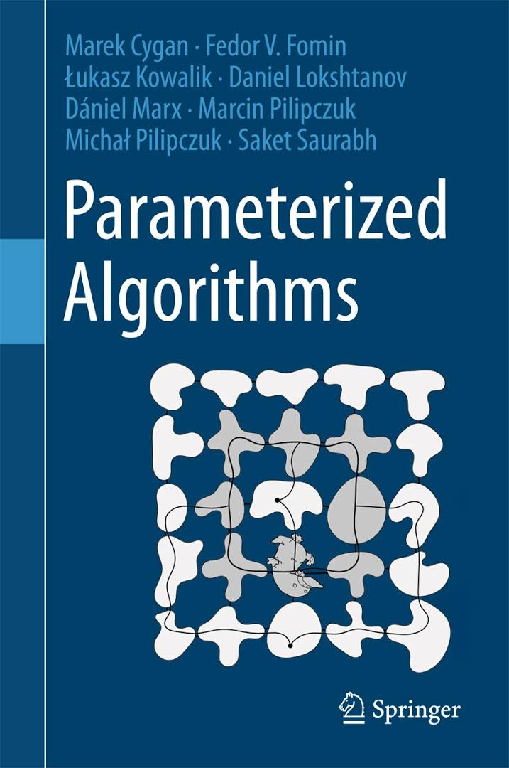
Further reading and exercises
Fomin and Kratsch Exact Exponential Algorithms Chapters 4
Cygan, Fomin, Kowalik, Lokshtanov, Marx, Pilipczuk, Pilipczuk, Saurabh Parameterized Algorithms Section 10.1

